Slide 1
Data pipeline for analytics
Airflow + Dbt + PostgreSQL + Metabase using Docker
The proposed architecture is based on a containerized analytics stack orchestrated with Docker, using Apache Airflow for workflow orchestration and scheduling, PostgreSQL as the central analytical data warehouse, dbt for data transformation and modeling following analytics engineering best practices, and Metabase for self-service BI and data visualization.

Slide 2
Architecture Overview
CSV Files - Source
Apache Airflow – Orchestrator
Python – Data Ingestion
PostgreSQL – Data Warehouse
DBT – Semantic Layer
Metabase – DataViz and Sandbox
Infraestructure as Code – Docker

Slide 3
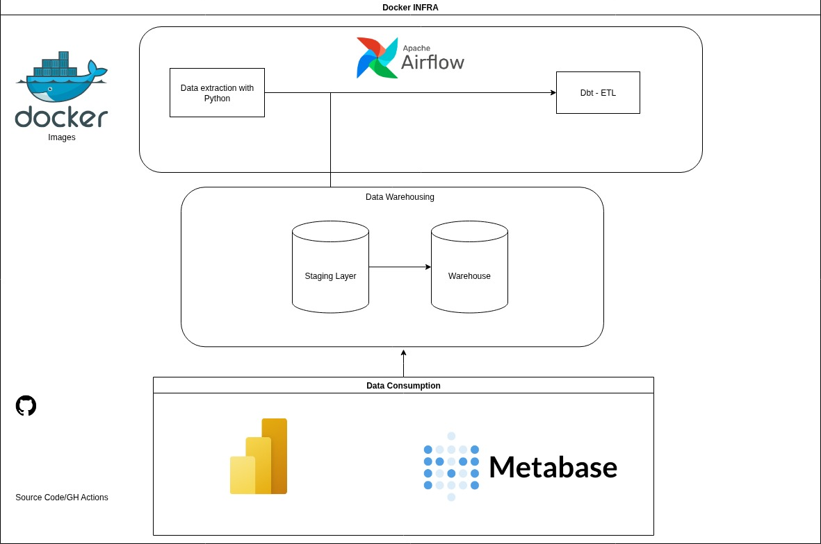

Slide 4
E2E Pipeline
Airflow DAG call python script to ingest source data into staging tables in DW;
DBT creates semantic model with facts and dimensions;
Physical tables are created under dw schema in DW;
Metabase connects to DW targeting analytical data

Slide 5
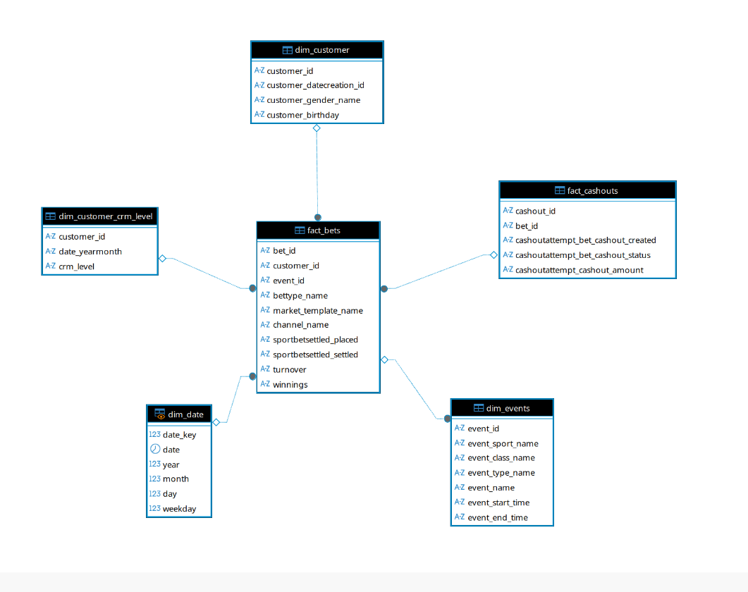

Slide 6
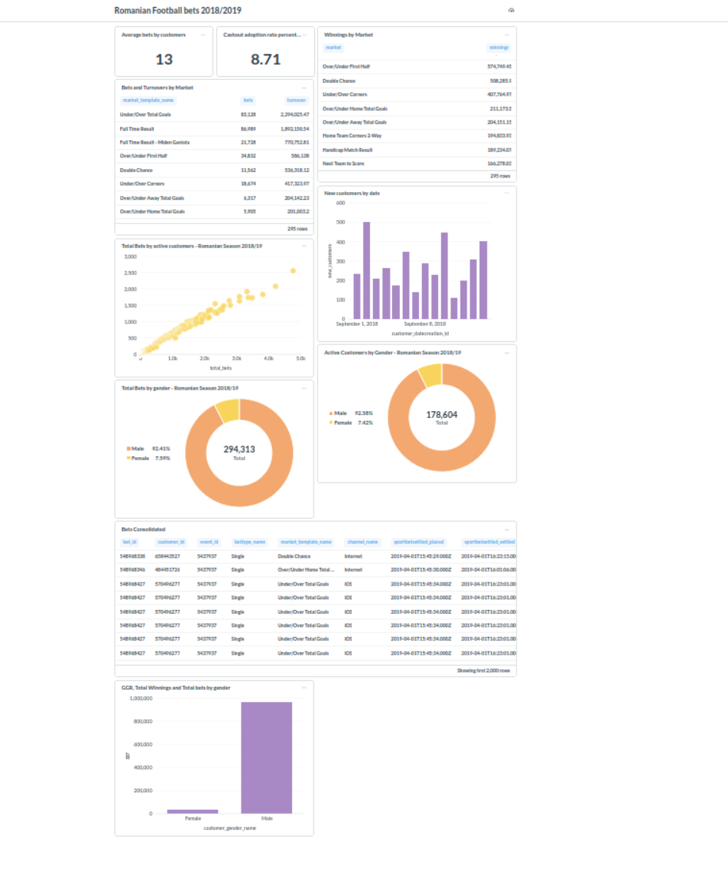

Slide 7
Metric examples
KPIS:
Turnovers;
Bets;
Winnings;
Ggr;
Cashout adoption;
New customers;
Dimensions:
Time;
Gender;
Market;
Device;
Event;
CRM Level

